Slide 1
Problem solving

Slide 2
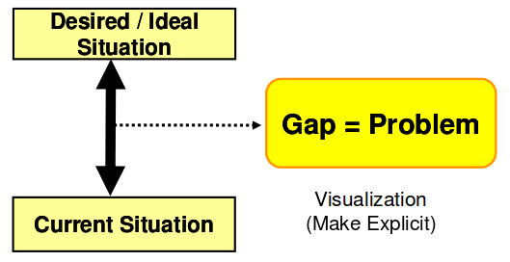
What is problem ?
Anything that deviates from standards & target.
Something that is difficult to deal with.

Slide 3
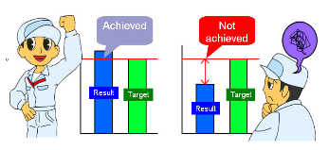
Problem solving steps:
Step 1 : Clarify the problem
Step 2 : Break down the problem
Step 3 : Target setting
Step 4 : Determining the root cause
Step 5 : Develop counter measures
Step 6 : Confirm results & processes

